Slide 1
Spiritually Integrated Psychotherapy
Kenneth I. Pargament, PhD
Presentation to Silver Hill Hospital
June 25, 2025
Our thanks to the John Templeton Foundation for its generous support of research reported in this presentation (#60791, 62033)
Our thanks to the John Templeton Foundation for its generous support of the research reported in this presentation (Grants 60791; 62033)

Slide 2
DISCLOSURES
In compliance with the ACCME Standards for Commercial Support of CME, I do not have any relevant financial relationships to disclose in relation to this presentation.

Slide 3
EDUCATIONAL OBJECTIVES
l). Describe three reasons why spirituality should be integrated into clinical care.
2). Recall three questions that can be a part of a spiritual assessment.
3). List three ways to help client access their spiritual resources and address their spiritual problems in treatment.

Slide 4
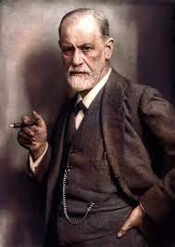
A Sea-Change in Attitudes
Early antagonism:
Religion works “by distorting the picture of the real world in delusional manner. . . by forcibly fixing [adherents]
in a state of psychical infantilism and by drawing
them into a mass delusion” (Freud, 1930,
pp. 31-32, Civilization and Its Discontents)

Slide 5
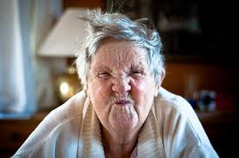
Story of Alice

Slide 6
Why Spiritually Integrated Mental Health Care is So Necessary
Religion is a cultural fact
People want spiritually sensitive care
Spirituality is a resource to many people

Slide 7
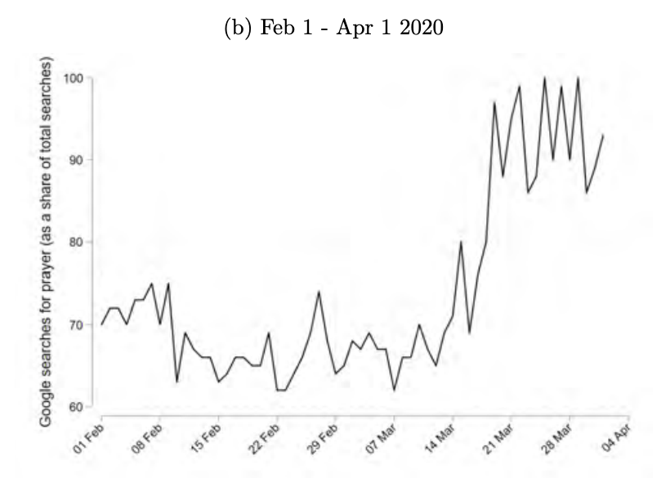
Turning to Faith in Stressful Times

Slide 8
Positive Religious Coping Predicts Positive Outcomes
In one study of residents in Mississippi after Hurricane Katrina, PRC tied to less risk of PTSD, depression, better quality of life, and less alcohol use (Henslee et al. 2015).
Ironson et al. (2016) Study of HIV patients in mid-stage of disease. Positive spiritual coping predicted higher rates of survival over 17 years.
Prati and Pietrantoni (2009) meta-analysis of 103 studies of predictors of stress-related growth. Positive religious coping predicted growth more strongly than social support, spirituality, and general coping (reappraisal, acceptance).

Slide 9
Why Spiritually Integrated Mental Health Care is So Necessary
Religion is a cultural fact
People want spiritually sensitive care
Spirituality is a resource to many people
Spirituality is linked to positive mental health
Spirituality is linked to poorer mental health

Slide 10
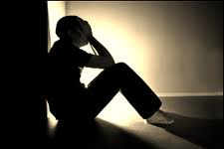
The “Seamy Side” of Spirituality
Extremism
Prejudice
Hypocrisy
Crippling guilt
Passivity
Denial
Struggles

Slide 11

Types of Spiritual Struggle
Divine Struggle
Struggle with the Demonic and Evil
Doubt-Related Struggle
Struggles of Ultimate Meaning
Moral Struggle
Interpersonal Struggle

Slide 12
Divine Struggles
“I’m suffering, really suffering. My illness is tearing me down, and I’m angry at God for not rescuing me, I mean really setting me free from my mental bondage. I have been dealing with these issues for ten years now and I am only 24 years old. I don’t understand why he keeps lifting me up, just to let me come crashing down again” (undergraduate dealing with bipolar illness).

Slide 13
Risks of Spiritual Struggles
Depression and anxiety
Major forms of psychopathology
Self-regulation problems (e.g., drug/alcohol abuse)
Suicidality
Immune system
Mortality
Religious/spiritual disengagement

Slide 14
Why Spiritually Integrated Mental Health Care is So Necessary
Religion is a cultural fact
People want spiritually sensitive care
Spirituality is a resource to many people
Spirituality is linked to positive mental health
Spirituality is linked to poorer mental health
Spiritually integrated therapy is at least as effective as other mental health treatments

Slide 15

A Sea-Change in Attitudes
From Antagonism to Confusion:

Slide 16
Lack of Graduate Training in Area of Religion and Spirituality
Only 25% of Ph. D. training programs in clinical psychology in the United States and Canada offer a course in religion and spirituality (Schafer et al., 2009)
Only 30% of masters level training programs in social work in the United States offer a course in religion and spirituality (Moffatt & Oxhandler, 2018)

Slide 17

A KEY QUESTION
How to integrate spirituality into mental health practice?

Slide 18
What is Spiritually Integrated Treatment?
Holistic
Pluralistic
Not a Competitor to Existing Treatments

Slide 19

Three Spiritual Competencies in Mental Health
Practitioners inquire about people’s spiritual and religious backgrounds, beliefs and practices as a routine part of mental health practice.
Practitioners appreciate the ways that spirituality and religion may support psychological well-being, and support clients in accessing their spiritual and religious strengths and resources.
Practitioners identify and address problems related to spirituality and religion that may adversely influence people’s psychological well-being.
APA Division 36 Task Force Chairs: Drs, Kari O’Grady, Cassandra Vieten
Vieten, C., & Lukoff, D. (2022). American Psychologist, 77(1), 26–38.

Slide 20
Building Spiritual Competencies
Spiritual Assessment

Slide 21
Distinguishing Spiritual Experience from Psychopathology (Griffith, 2010)
Is there a cultural context for the spiritual experience?
Do brain executive functions operate normally in usual life?
Do spiritual beliefs help or hurt person’s relations, work, and daily life?
Are there other associated symptoms of psychotic disorder, such as positive symptoms (e.g., paranoia)?
Has there been a robust response to pharmacological treatment?

Slide 22
Initial Spiritual Assessment
SALIENCE OF SPIRITUALITY:
Do you see yourself as a religious or spiritual person? If so, in what way?
SALIENCE OF RELIGIOUS AFFILIATION:
Are you affiliated with a religious or spiritual denomination or community? If so, which one?
SALIENCE OF SPIRITUALITY TO THE PROBLEM:
Has your problem affected you religiously or spiritually? If so, in what way?
SALIENCE OF SPIRITUALITY TO THE SOLUTION?
Has your religion or spirituality been involved in the way you have coped with your problem? If so, in what way?

Slide 23
How to Invite a Spiritual Conversation? Communicate an Openness to Learning
“I’d like to learn about that.”
“Could you tell me more?”

Slide 24
Implicit Spiritual Assessment
From what sources do you draw strength and courage to go on?
Where do you find peace?
What sustains you in the midst of your troubles?
Why is it important that you are here in this world?
When have you felt most deeply and fully alive?
What causes you the greatest despair and suffering?

Slide 25
Building Spiritual Competencies
Spiritual Assessment
Accessing Spiritual Resources

Slide 26


Losing Your Rhythm
Physically
Psychologically
Behaviorally
Socially
Spiritually

Slide 27
Story of Alice

Slide 28

“Fireflies” by Alice
Remember when you were a child in the summertime at night. There were tiny little yellow lights going off and on continuously. I always thought they were flies carrying little lanterns so they could see their way in the darkness. Sometimes the fireflies blend in with the stars.
Remember when you feel in the darkness.
Look around, there’s always a flicker of light
to give you a glimmer of hope.
Think back when you were a child and remember the fly carried his lantern. He found his way. You will too.”

Slide 29

Story of Bob the Good Samaritan

Slide 30

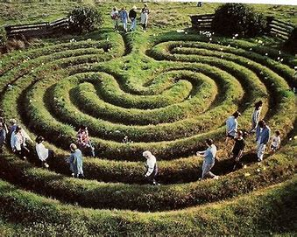

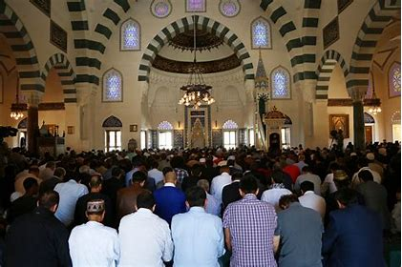

The Variety of Spiritual Resources
Cognitive
Behavioral
Experiential
Relational
Motivational

Slide 31

Ten Tips for Addressing Spritual Resources in Psychotherapy
Tip 1: Take a deep breath

Slide 32

Ten Tips for Addressing Spiritual Resources in Psychotherapy
Tip 2: Be self-aware

Slide 33

Ten Tips for Addressing Spiritual Resources in Psychotherapy
Tip 3: Give yourself permission to raise spiritual issues in psychotherapy

Slide 34

Ten Tips for Addressing Spiritual Resources in Psychotherapy
Tip 4: Remember that spiritual issues should be integrated into rather than set apart from psychotherapy

Slide 35
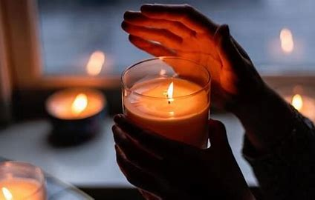
Ten Tips for Addressing Spiritual Resources in Psychotherapy
Tip 5: Remember you are discussing
sacred matters with your clients.

Slide 36

Ten Tips for Addressing Spiritual Resources in Psychotherapy
Tip 6: Tailor spiritual resources to clients’ specific needs, preferences, and problems

Slide 37
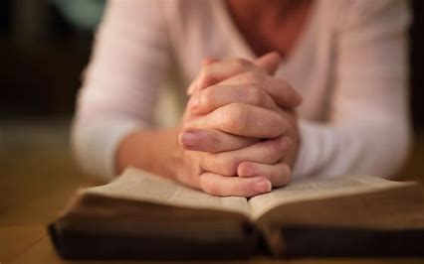
Ten Tips for Addressing Spiritual Resources in Psychotherapy
Tip 7: Remind clients that it takes time to reap the benefits from spiritual resources

Slide 38

Ten Tips for Addressing Spiritual Resources in Psychotherapy
Tip 8: Be ready to address barriers to integrating spiritual resources in
psychotherapy.

Slide 39

Ten Tips for Addressing Spiritual Resources in Psychotherapy
Tip 9: Work within your own professional and personal boundaries

Slide 40


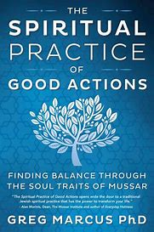
Ten Tips for Addressing Spiritual Resources in Psychotherapy
Tip 10: Have additional spiritual resources on-hand for clients interested in learning more

Slide 41
Spiritual Competencies
Spiritual Assessment
Accessing Spiritual Resources
Addressing Spiritual Problems

Slide 42
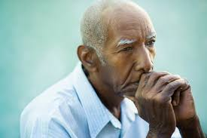
The Story of George

Slide 43
Practical Implications: What Not to Do
Don’t change the subject
Don’t assume you understand
Don’t judge
Don’t offer easy answers or bromides
Don’t slip into the role of theologian or clergy

Slide 44
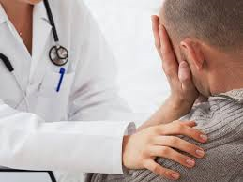

Practical Implications
Listen to and Normalize
Spiritual Struggles

Slide 45

Practical Implications
Listen to and Normalize Spiritual Struggles
Encourage Acceptance rather than Avoidance

Slide 46

R. D. Laing (1964)
“There is a great deal of pain in life and perhaps the only pain in life that can be avoided is the pain that comes from trying to avoid pain.”

Slide 47

Practical Implications
Listen to and Normalize Spiritual Struggles
Encourage Acceptance rather than Avoidance
Foster Hope and Wholeness

Slide 48
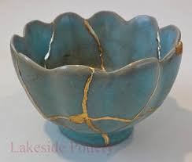
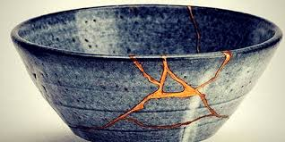
Kintsugi: Fostering Greater Wholeness and Hope through Struggle

Slide 49
Practical Implications
Listen to and Normalize Spiritual Struggles
Encourage Acceptance rather than Avoidance
Foster Hope and Wholeness
Broaden and Deepen Spiritual Resources

Slide 50
Picture God as a Waterfall
“Picture God as a waterfall within you. . . pouring down cool, refreshing water. . . the waters of love, healing, restoration throughout your body. . . a cool, refreshing waterfall washing down over your head, your face, your shoulders, your neck, out through your arms, down your legs, out through your toes, refreshing bringing life, quenching thirst. . . renewing, refreshing, restoring” (Murray-Swank, 2003, p. 232).

Slide 51
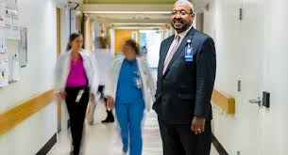
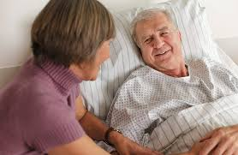
Practical Implications
Listen to and Normalize Spiritual Struggles
Encourage Acceptance rather than Avoidance
Foster Hope and Wholeness
Broaden and Deepen Spiritual Resources
Collaborate with
Other Disciplines

Slide 52

Can We Do It?

Slide 53

Online SCT-MH Course: Mental Health Care Providers
Multidisciplinary
Basic competency
Empirically-based content
Adult-learning instructional methods
Online format
8 modules (8-10 hours)
Evaluated changes in attitudes, knowledge, and skills before and after the SCT-MH program with 169 MH providers (Pearce et al., 2019; 2020)
Notes:
Similar to the study we did in 2019 with mental health providers
Enhanced it with video case critiques and clinical practice activities that students could use with their clients

Slide 54
Results
 | t | p | Pre | Post
Attitude | 3.07 | .003 | 6.25 | 6.41
Knowledge | 14.06 | <.001 | 4.81 | 5.80
Skills | 11.28 | <.001 | 4.01 | 5.00
Spiritual competencies significantly increased from pre- to post-training on measures of attitudes, knowledge, and skills.

Slide 55
Quantitative Feedback
How helpful was this training in preparing you to engage in spiritually integrative psychotherapy?
Extremely 37%, Very 53%, Somewhat 10%, Not very 1%
How relevant was this training to your clinical work?
Extremely 32%, Very 50%, Somewhat 16%, Not Very 2%
How satisfied were you with this training program?
Extremely 39%, Very 50%, Somewhat 10%, Not very 1%
Would you recommend this program to your colleagues?
Yes 95% Maybe 5%
Did you find the online learning format easy to use?
Yes 97% No 3%

Slide 56
Qualitative Feedback
“This was very informative. It helped me see that spirituality and religion could be integrated without it being seen as ‘conversion’ or trying to put your viewpoints on others. But rather, using where they are already coming from as a source of healing and understanding.”

Slide 57

Thinking Globally

Slide 58

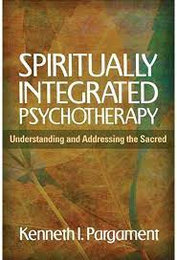

For Further Information

Slide 59

Q & A

Slide 60

Thank You!!!

