Slide 1


AI Enhanced Supervision-Enhanced Psychotherapy Supervision Through Simulation, Feedback, and Deliberate Practice
Jeff Katzman, MD
Brad Bloom, MSW
September 15, 2026

Slide 2
Disclosures:
In compliance with the ACCME standards for commercial support of CME, the speakers do not have any relevant financial relationships to disclose in relation to this presentation.

Slide 3
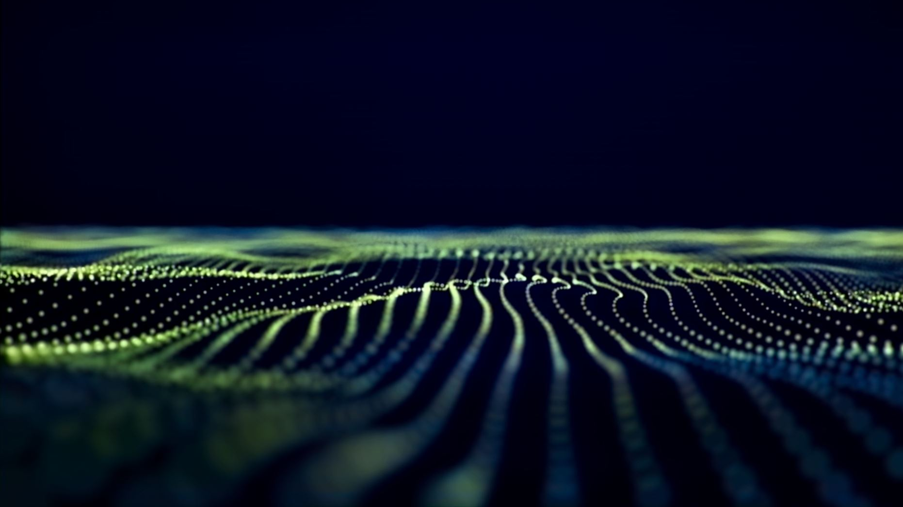
Objectives:
9.15.26 – Session 1: AI as an Adjunct to Clinical Education
As a result of participating in this activity, you should be able to:
Explain how AI can supplement traditional supervision while maintaining the importance of human clinical oversight

Slide 4
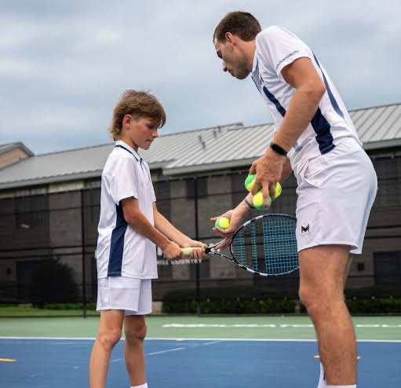
The Tennis Lesson

Slide 5
Deliberate Practice: The Missing Loop
Expertise grows through focused practice, feedback, adjustment, and another attempt.
1
2
3
4
Practice
Try a specific therapeutic skill
in a challenging interaction
Feedback
Identify what helped,
what missed, and what to change
Reflect
Make the clinical reasoning
and therapist response explicit
Repeat
Re-enter the interaction
and practice the revised move
AI makes the loop repeatable: the learner can practice a difficult moment again—without risk to an actual patient.
Chow et al., 2015 • Nurse et al., 2025 • Rousmaniere, 2025

Slide 6
AI as a Clinical Training Partner
Trainers guide the learning. AI creates the practice environment.
1
2
3
TRAINERS SET THE DIRECTION
AI CREATES THE PRACTICE
STUDENTS LEARN THROUGH
EXPERIENCE
Learning goals
Learner experience level
Clinical setting and complexity
Realistic patient backgrounds
Different clinical presentations
Natural emotions, defenses, and variability
Practice interviewing and therapy skills
Encounter resistance and uncertainty
Pause for supervision and try again
Trainers provide the clinical judgment. AI creates a responsive practice environment.

Slide 7
What AI Adds to the Training Environment
Not a replacement for supervision—a new place to practice before and between supervision.
PRACTICE
FEEDBACK
PERSPECTIVE
SIMULATED PATIENT
Responds dynamically to the therapist’s interventions
SKILLS COACH
Offers structured feedback on strengths and next-step targets
MULTIPLE LENSES
Re-examines the same encounter through different psychotherapy frameworks
AI-Enhanced Psychotherapy Supervision

Slide 8
The Destination Is Still Human Supervision
AI practice becomes material for reflection together—not an endpoint.
AI PRACTICE
Learner experiments
independently
BRING IT BACK
Encounter + feedback
enter the group
REFLECT TOGETHER
Trainees and supervisors
question, compare, mentalize
RETURN TO PRACTICE
A more specific skill target
for the next attempt
The question is not “Can AI supervise?” It is “How can AI help us practice more deliberately—and make human supervision richer?”

Slide 9
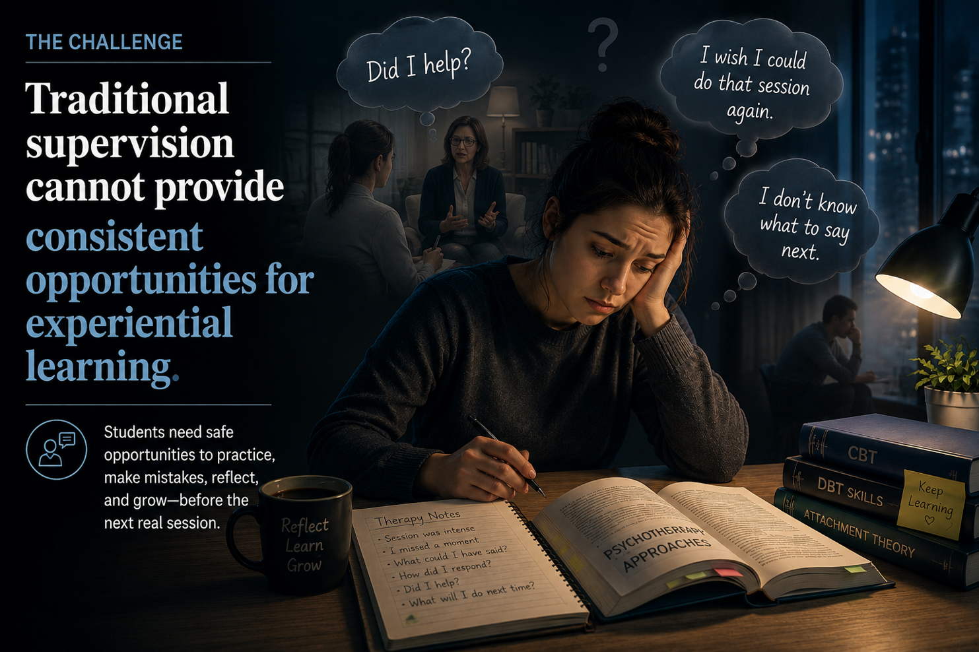


Slide 10
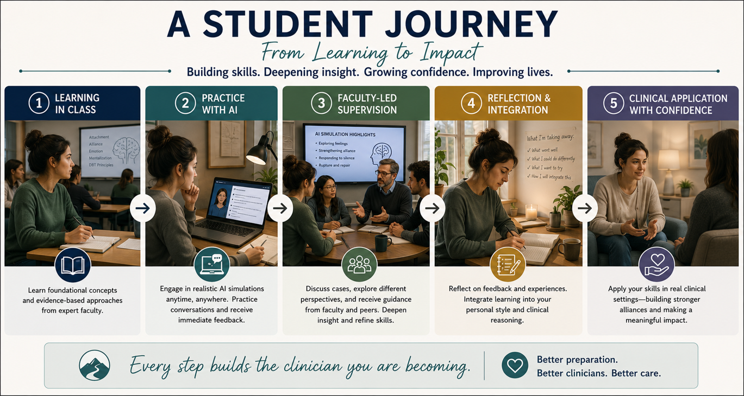


Slide 11
